Slide 1

Designing learner centric MOOCs
Sridhar Iyer
Joint work with Sahana Murthy, Sameer Sahasrabudhe, Jayakrishnan M.
Indian Institute of Technology Bombay
This presentation is released under Creative Commons-Attribution 4.0 License.
You are free to use, distribute and modify it , including for commercial purposes,
provided you acknowledge the source.

Slide 2
Educational Technology, IIT Bombay
Inter-Disciplinary Program, started 2010
Core faculty, also from depts of Engineering, Science, Design, H&SS
R&D, PhD program
Project TUET: Teacher use of educational technologies
Project TELoTS: Technology enhanced learning of thinking skills
Consultancy : Learner-centric pedagogy training & content-creation for industry
Outreach: FDPs, MOOCs

Slide 3
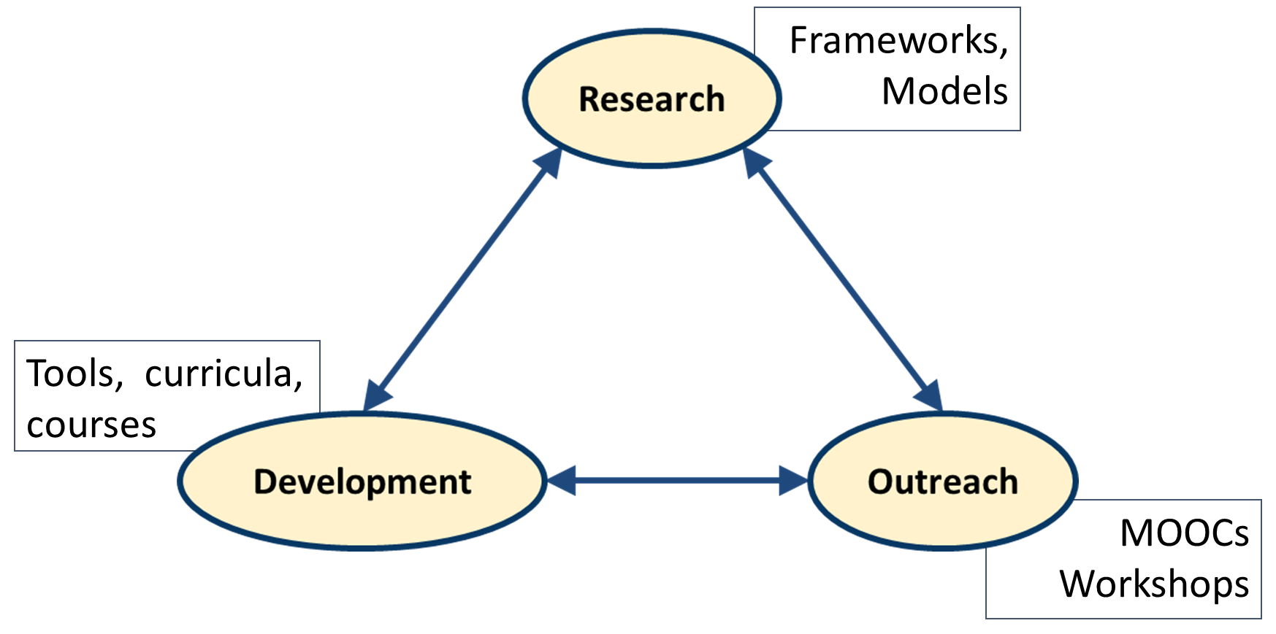
Project TUET

Slide 4
Scenario
In order to create a MOOC, an instructor creates lecture videos, provides exercises, clarifies queries on discussion forums and does assessment.
What has this instructor missed?

Slide 5
What do you think – what has been missed?
*

Slide 6
What’s missing
Attention to learner motivation
Getting learners to express their reasoning
Opportunities for immediate micro-application
Formative assessment and instant feedback
Explicit activities to foster peer-learning
Ensuring learner connect during the MOOC
Established theories of How People Learn is missing

Slide 7
Traditional MOOCs
Provide anytime anywhere access to learners for:
Information – lectures, resources
Assessment - activities and exercises
Discussion – with peers and instructor(s)

Slide 8
Implications
Common MOOC problems may persist - low student engagement, low participation in discussion forums, low completion rates
Problems of engagement worsen in a MOOC setting - distance, scale and diversity of learners are all high

Slide 9
Need - Learner Centric MOOCs
Not sufficient to focus only on the technology features
Not effective to mimic a typical classroom
Need:
Incorporate learner-centric approaches
using technology affordances

Slide 10
Learner Centric MOOC Model
LCM MODEL HELPS AN INSTRUCTOR GO FROM
Teacher-Centric Classroom
Leaner-Centric MOOC
Conceptualize
Teacher-Centric MOOC
Create
Learner-Centric Classroom
Conduct

Slide 11
Overview of Learner Centric MOOC Model
Learner Experience Interaction
Learning Dialogs
Learning by Doing
Learning Extension
Interaction
Lines

Slide 12
Overview of Learner Centric MOOC Model
Learner Experience Interaction
Learning Dialogs
Learning by Doing
Learning Extension
Content + Reflection Spot
Interaction
Lines

Slide 13
Overview of Learner Centric MOOC Model
Activities + Customized Feedback
Learner Experience Interaction
Learning Dialogs
Learning by Doing
Learning Extension
Content + Reflection Spot
Interaction
Lines

Slide 14
Overview of Learner Centric MOOC Model
Activities + Customized Feedback
Resources + Assimilation Quiz
Learner Experience Interaction
Learning Dialogs
Learning by Doing
Learning Extension
Content + Reflection Spot
Interaction
Lines

Slide 15
Overview of Learner Centric MOOC Model
Focus question for discussion + Peer interaction+ Reflection Quiz
Activities + Customized Feedback
Resources + Assimilation Quiz
Learner Experience Interaction
Learning Dialogs
Learning by Doing
Learning Extension
Content + Reflection Spot
Interaction
Lines

Slide 16
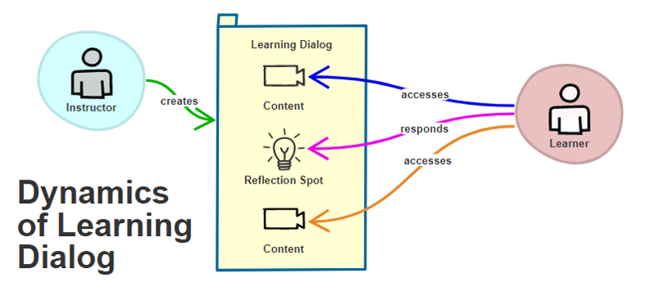
LeD Dynamics

Slide 17
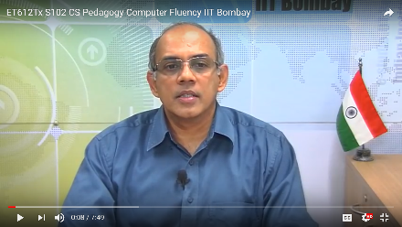
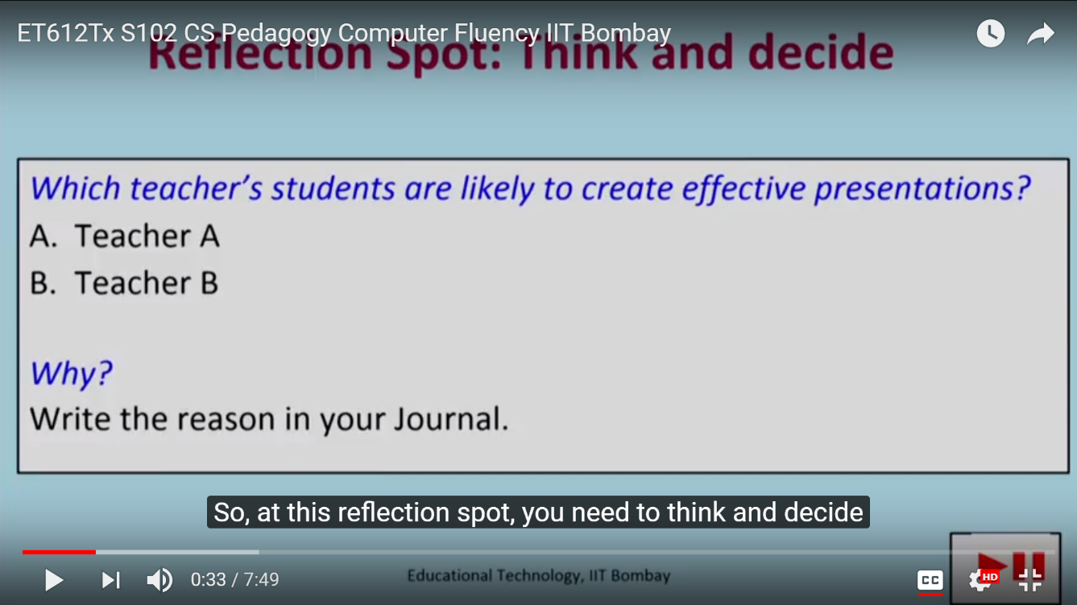
LeD Example in IITBombayX
Weblink

Slide 18
LeD Details
Content - part of short video / text
Reflection spot:
Objective: learner engagement with content (not assessment)
Connected to the immediate preceding content in the LeD.
Learner needs to express their ideas via poll or MCQ or free form writing
Takeaway: Include reflection spots in content (videos/text)

Slide 19
Evidence
Average retention rate in FDP101x:
LeD videos : 69.9%
Regular videos : 55.73%
Participants highlighted relevance and usefulness of LeD.
5000+ course journal submissions (out of 7000 participants) highlighted Reflection Spot activities.

Slide 20
From traditional to Learner-Centric MOOC
Lectures and demos
Learning Dialogs
One or more units of
[Content + Reflection Spot]
Takeaway: Include reflection spots in content (videos/text)

Slide 21
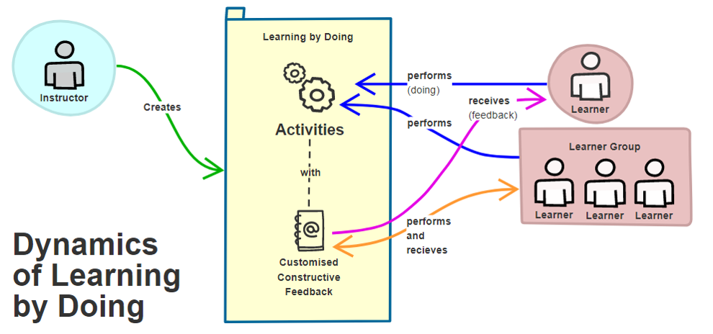
LbD Dynamics

Slide 22
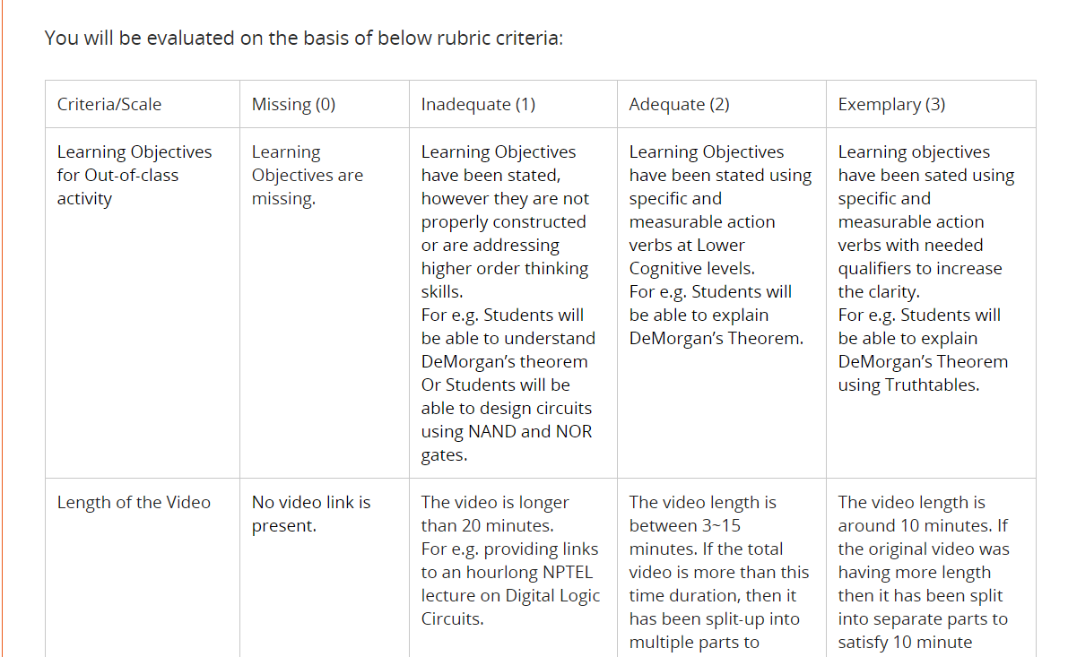
LbD Example in IITBombayX
LbD Activity:
Design a flipped classroom for a topic in your course.
Rubrics for peer-assessment
Link to course

Slide 23
LbD Details
Customized constructive feedback:
MCQ – Each wrong option should have corresponding feedback – what is wrong with that option, how to get to the correct answer.
Assignments – Have rubrics for self- and peer-assessment.
Peer assessment – Learning happens for both the receiver and giver of the feedback.

Slide 24
Evidence
91.8% people found LbD activities useful [N=695]
“LbD activities and resource creation activities were very useful and regular practise of the same help a teacher to improve quality in teaching and learning process”
“ LeD and LbD helped me to understand the minute difference between standard practices and my own practice of lesson design.”

Slide 25
From traditional to Learner-Centric MOOC
Assignments
Learning by Doing
Activities consisting of
[Concept attainment, Apply knowledge
+ Customized feedback, peer review]
Takeaway: Follow up each LeD with a corresponding LbDs.

Slide 26
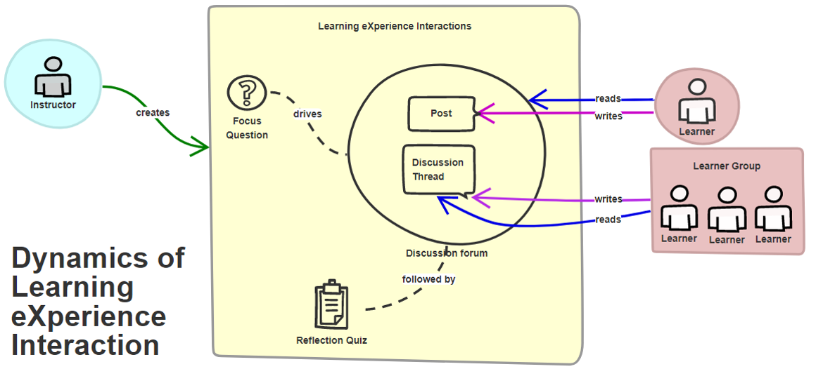
LXI Dynamics

Slide 27
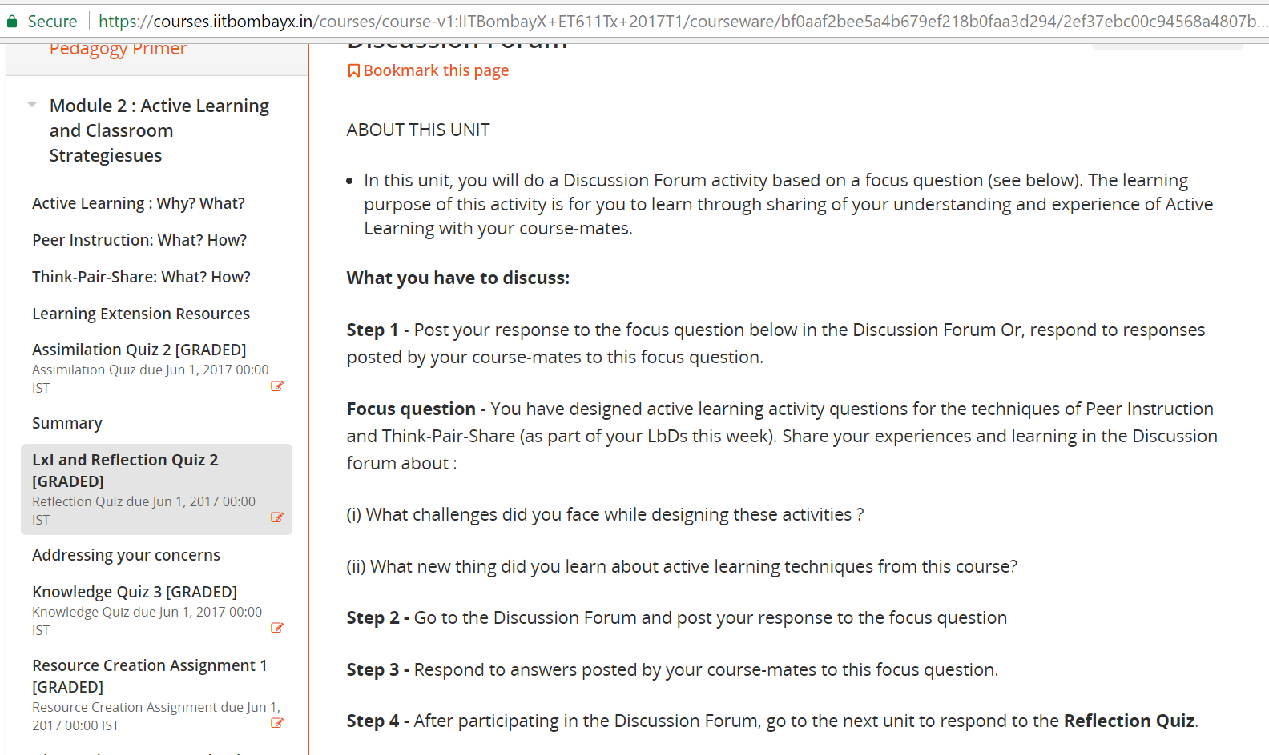
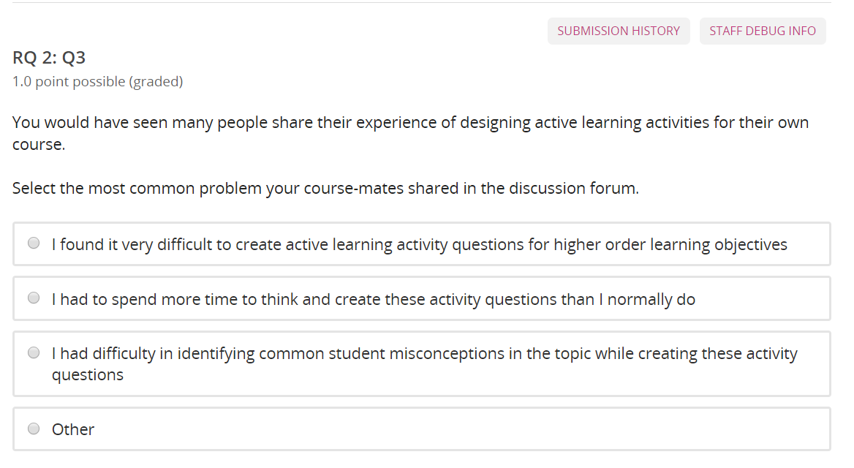
LxI Example in IITBombayX
Reflection Quiz
Reflection Quiz

Slide 28
LxI Details
Focus question: purpose – ensure discussion does not scatter
Examples: Post experience of implementing active learning
Reflection quiz: purpose - ensure learner participation
Examples: What were the common posts? What is your main learning?

Slide 29
Evidence
“In your FDP, discussion forum is the best feature where I can interact with like minded teachers from institutes all over India. ”
“Discussion with other people about the subject, and TPS and PI activities are very interesting that motivated me a lot to complete the course.”

Slide 30
From traditional to Learner-Centric MOOC
Learner-learner
interaction
Learning Experience Interaction
Activities consisting of
[Focus question for discussion + Peer Interaction + Reflection quiz]
Takeaway: Exploit peer learning; create discussions centered around a focus question.
Ensure learner participation through reflection quiz.

Slide 31
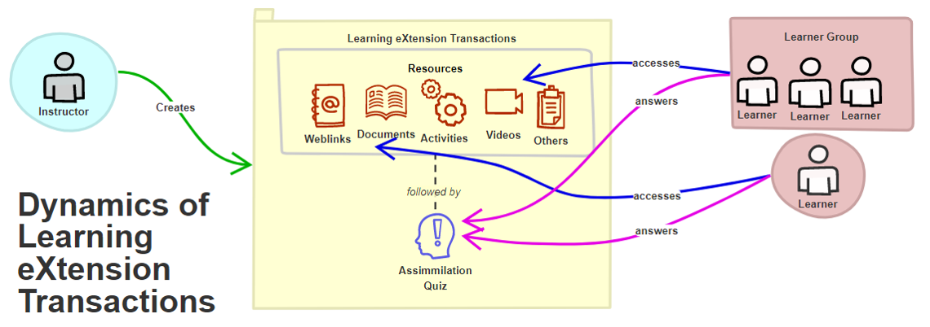
LxT Dynamics

Slide 32
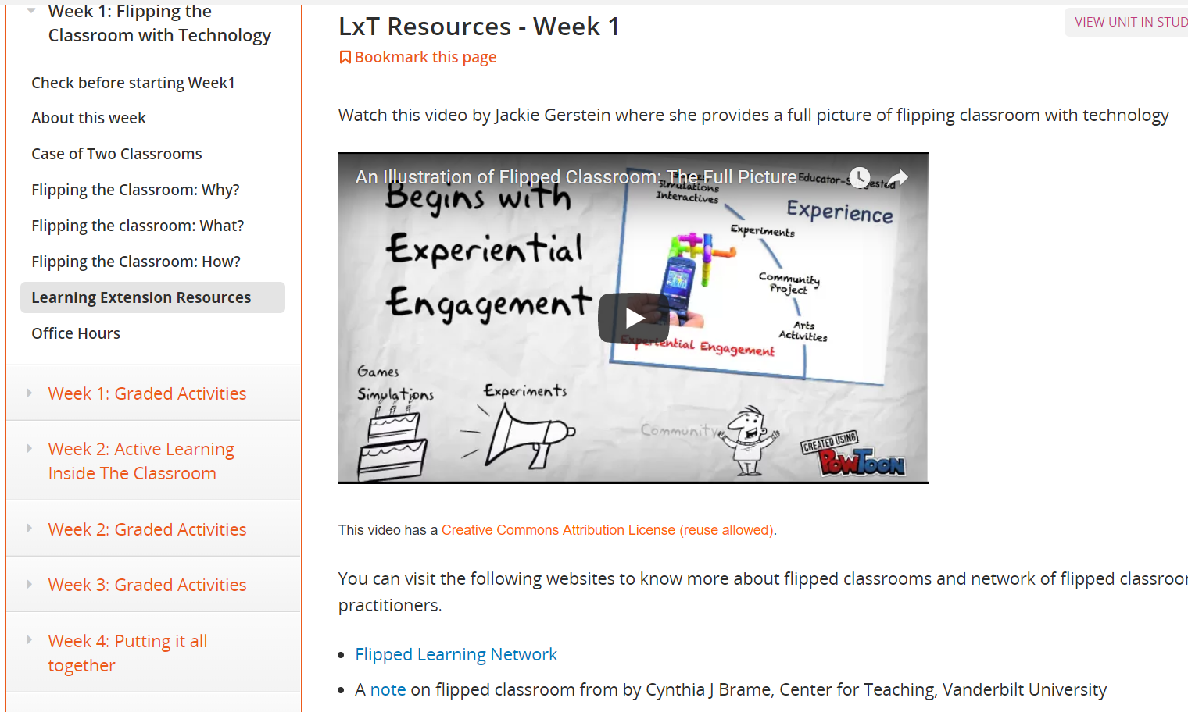
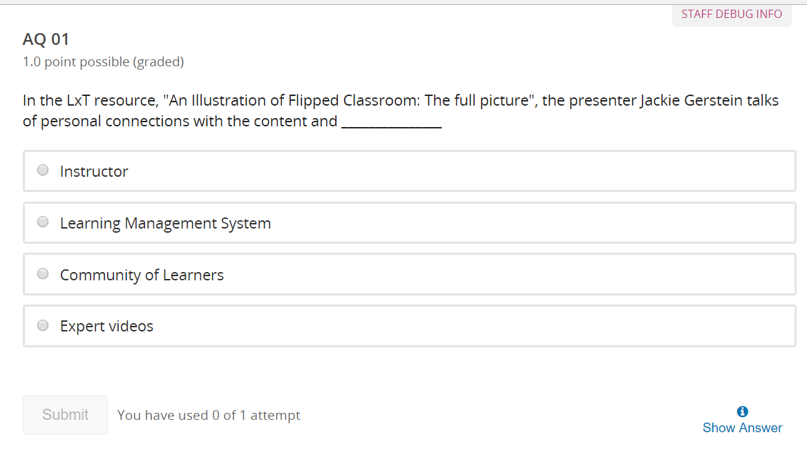
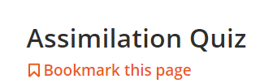
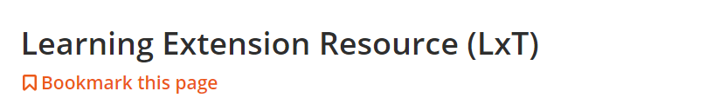
LxT Example in IITBombayX
Weblink

Slide 33
LxT Details
Handling diversity: examples / resources for different
Domains
real-life applications
voices from the field,
advanced topics, languages, …
Assimilation quiz: keep it simple
Objective – Ensure that learner has “seen” one LxT of his/her interest from the given.

Slide 34
Evidence
End of course survey:
“Having the assimilation quiz following the LxT resources made us look into those resources […] we realized that the LxT resources gives you details about strategies and their uses at different places” [ET611Tx participant]
“Watching videos of Prof. Mazur made me realize that students in my class may also be nodding their heads without really understanding the concept” [ET601Tx participant]

Slide 35
From traditional to Learner-Centric MOOC
Additional material
Learning eXtension Transaction
[Links to resources for diverse cohorts + Assimilation Quiz]
Takeaway: Provide a rich set of LxT resources, and
close the loop with Assimilation Quiz.

Slide 36
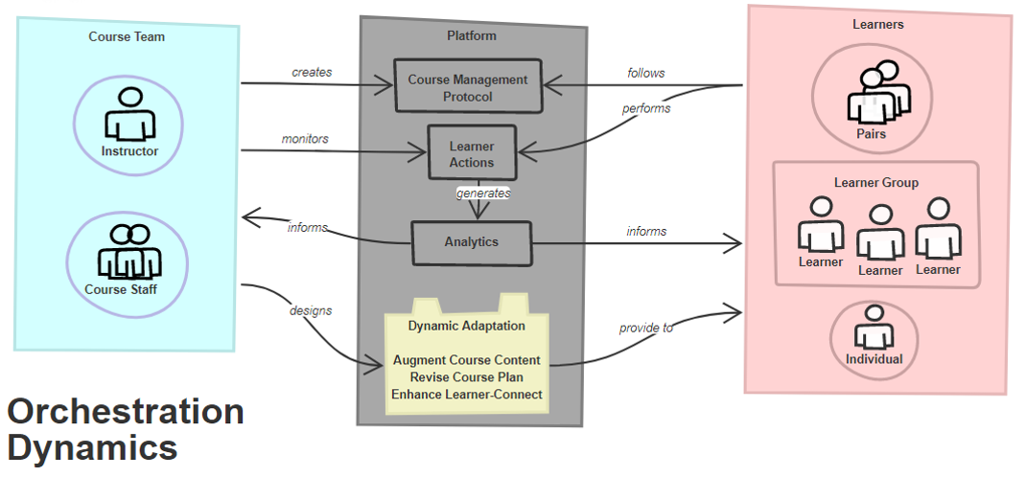
Orchestration Dynamics

Slide 37
Did it work?
ET601Tx : Jan- Mar 2016, 5500 participants, engg instructors
Active participants: 67%
(participated in at least one activity – LeD, submit LbD, LXI post, quiz …)
Persistence rate: 37%
(completed all activities / active participants)
Completion rate: 23%
(completed all activities / registered participants)

Slide 38
Final summary
TRADITIONAL MODEL
Lectures and demos
Assignments and activities
Discussion forums
Additional materials
LCM MODEL
Learning Dialogs (LeD)
Learning by Doing (LbD)
Learning eXperience Interaction (LxI)
Learning eXtension Transaction (LxT)
Incorporate learner-centric approaches in your MOOC.
Apply LCM model to design a MOOC for your platform.

Slide 39
Thank you! www.et.iitb.ac.in In IITB, July 9-13: ICALT 2018 IEEE International Conference on Advanced Learning Technologies http://www.et.iitb.ac.in/icalt2018/

Slide 40
Other such talks Google - Sridhar Iyer, IIT Bombay Get to my web page - www.cse.iitb.ac.in/~sri Click on ‘Talks’
This presentation is released under Creative Commons-Attribution 4.0 License.
You are free to use, distribute and modify it , including for commercial purposes,
provided you acknowledge the source.

